Slide 1







PROJECTS | PRODUCTS | COURSE | INTERNSHIP
info@discoverprojects.com
www.discoverprojects.com
pro.aiskool@gmail.com
www.aiskool.com
Shop no. 2, Narayan Smurti Building, Opp. Saraswati Book Depot,
Near CIDCO Bus Stop, Thane West, India.
+91 9967478289 / +91 9167769993

Slide 2


Bank Marketing
Relevant Image

Slide 3
Introduction and Application
The objective is build a machine to understand the Bank Marketing system and its audience with the help of Logistic Regression.

Slide 4
Working
FIRST STEP WAS TO COLLECT DATA FROM DIFFERENT SOURCES FOR OUR PROBLEM STATEMENT .
THEN WE HAVE TO CLEAN , PROCESS CATEGORICAL DATA AND NORMALISE IT.
THEN WE SHOW VARIOUS ANALYSIS USING GRAPHS.
SPLIT THE DATA INTO TRAINING AND TEST SET.
SELECT AN ALGORITHM.
FITTING THE MODEL TO TRAINING SET.
SAVING THE MODEL
CHECK ACCURACY OF TRAINED DATA W.R.T TRAIN SET.
TEST THE TRAINED MODEL W.R.T TESTING SET.
CHECK ACCURACY OF TEST DATA W.R.T TEST SET.
BASED ON THE GENERATED GRAPHS WE UNDERSTAND THE BANK MARKETING SYSTEM.

Slide 5
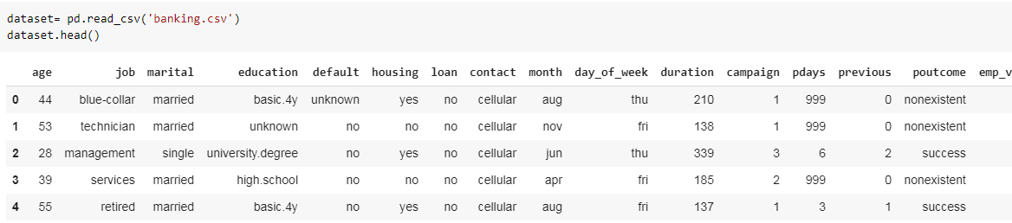
Working and Building
This is the data that we are using in the understanding of bank marketing system. The source of dataset is Kaggle.
We have used the read_csv() function of pandas to read the .csv file for dataset and head() function to display the first five lines of dataset.

Slide 6
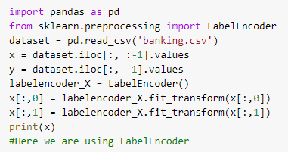
Handling Categorical Data
Label encoding is simply converting each value in a column to a number.

Slide 7
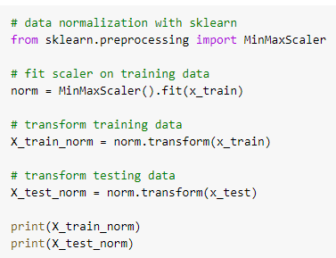
Normalise Data
MinMaxScaler transforms features by scaling each feature to a given range.
fit(self, X[, y]):
Compute the minimum and maximum to be used for later scaling.
transform(self, X):
Scale features of X according to feature_range.

Slide 8
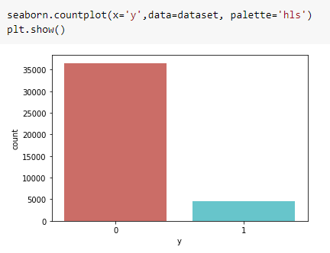
Graphs (1)
countplot. Shows the counts of observations in each categorical bin using bars. A count plot can be thought of as a histogram across a categorical, instead of quantitative, variable.
**In the same way the graphs in the next few slides have been plot.**

Slide 9
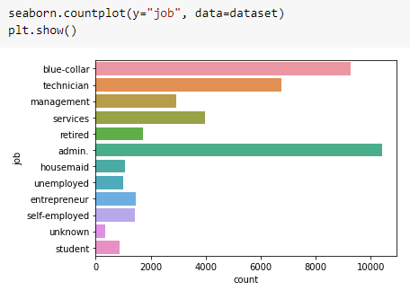
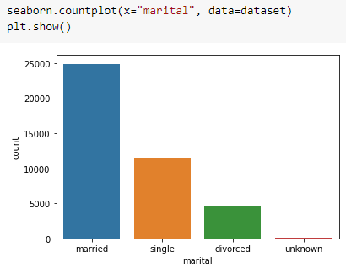
Graphs (2)

Slide 10
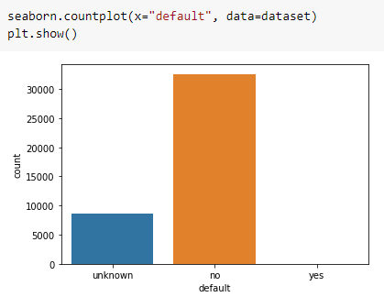
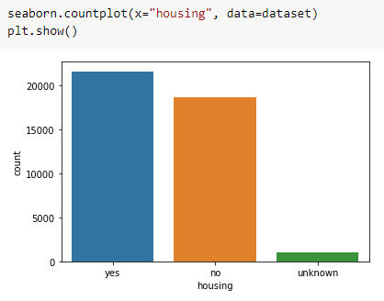
Graphs (3)

Slide 11
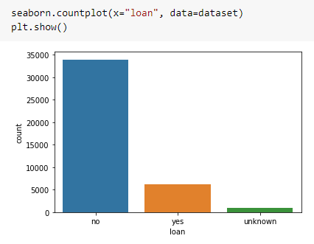
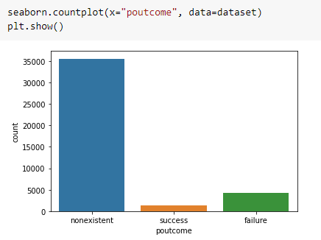
Graphs (4)

Slide 12
Splitting Data
Python has a library sklearn which contains a function ‘train_test_split’. This function is used to Split arrays or matrices into random train and test subsets.
test_size float or int, default=None:
If float, should be between 0.0 and 1.0 and represent the proportion of the dataset to include in the test split. If int, represents the absolute number of test samples. If None, the value is set to the complement of the train size. If train_size is also None, it will be set to 0.25.
random_state int or RandomState instance, default=None
Controls the shuffling applied to the data before applying the split. Pass an int for reproducible output across multiple function calls.

Slide 13

Selecting Algorithm
The algorithm that we have used is Logistic Regression.
Make an instance of the model.
model is the object for LogisticRegression().

Slide 14

Fitting the model to trained dataset
We have used the fit() function to fit our model to the training dataset and hence passed the parameters for the same.

Slide 15
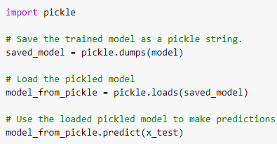
Saving the model
We can use the Pickle library in Python to save our model. In this code we can see that the model has been saved as a string.
So, first we save the model as a string, then we load it and use it to make predictions.

Slide 16

Confusion Matrix
Confusion Matrix function is present in the sklearn library of Python. A confusion matrix is a table that is often used to describe the performance of a classification model (or “classifier”) on a set of test data for which the true values are known. It allows the visualization of the performance of an algorithm.
We have used slicing so as to make both the arrays of same size.

Slide 17
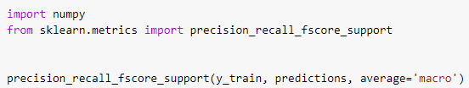
Precision, Recall, Support, Fscore
The precision is intuitively the ability of the classifier not to label as positive a sample that is negative. The recall is intuitively the ability of the classifier to find all the positive samples.The F-beta score can be interpreted as a weighted harmonic mean of the precision and recall, where an F-beta score reaches its best value at 1 and worst score at 0.The support is the number of occurrences of each class in y_true. We have used the precision_recall_fscore_support() function for the same.
**In the same way we will calculate the confusion matrix, precision, recall, support and fscore for the test dataset.**

Slide 18
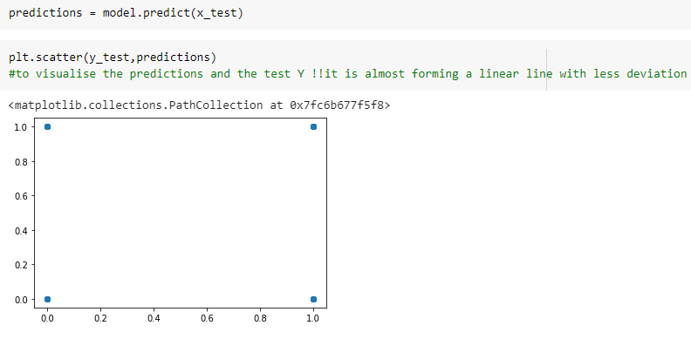
Prediction
We have used the predict() function for making the predictions on our model. Also. scatter() method is used to plot the graph for our predictions.

Slide 19
Evaluate, Tune and Improve Neural Network
In this code we have used the MSE, MAE and RMSE method for evaluation.
Mean Absolute Error: We know that an error basically is the absolute difference between the actual or true values and the values that are predicted.
Mean Square Error: MSE is calculated by taking the average of the square of the difference between the original and predicted values of the data.
Root Mean Square Error: RMSE is the standard deviation of the errors which occur when a prediction is made on a dataset. This is the same as MSE (Mean Squared Error) but the root of the value is considered while determining the accuracy of the model.

Slide 20
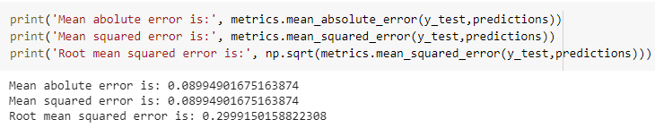
Calculating Efficiency:
We have used the mean_absolute_error(), mean_squared_error() and square root of mean_squared_error() functions of metrics from sklearn library of Python to calculate the MAE, MSE and RMSE values.

Slide 21

Accuracy:
Accuracy is the most intuitive performance measure and it is simply a ratio of correctly predicted observation to the total observations. One may think that, if we have high accuracy then our model is best. Yes, accuracy is a great measure but only when you have symmetric datasets where values of false positive and false negatives are almost same. Therefore, you have to look at other parameters to evaluate the performance of your model.
Accuracy = TP+TN/TP+FP+FN+TN

Slide 22
FAQ
What is the use of read_csv()?
read_csv() is an important pandas function to read csv files and do operations on it.
What is the use of iloc?
iloc returns a Pandas Series when one row is selected, and a Pandas DataFrame when multiple rows are selected, or if any column in full is selected. To counter this, pass a single-valued list if you require DataFrame output.
What is Logistic Regression and when is it used?
Logistic regression is famous because it can convert the values of logits (logodds), which can range from -infinity to +infinity to a range between 0 and 1. As logistic functions output the probability of occurrence of an event, it can be applied to many real-life scenarios. It is for this reason that the logistic regression model is very popular.

Slide 23
FAQ
4. What is the difference between the RMSE and RMSLE method for measuring accuracy?
The value of the RMSE explodes in magnitude as soon as it encounters an outlier. In contrast, even on the introduction of the outlier, the RMSLE error is not affected much i.e. RMSLE is very robust when outliers come into play.
5. Can we use RMSLE method for measuring accuracy?
Yes, we can.

Slide 24
FAQ
6. Why can’t linear regression be used in place of logistic regression for binary classification?
The reasons why linear regressions cannot be used in case of binary classification are as follows:
Distribution of error terms: The distribution of data in case of linear and logistic regression is different. Linear regression assumes that error terms are normally distributed. In case of binary classification, this assumption does not hold true.
Model output: In linear regression, the output is continuous. In case of binary classification, an output of a continuous value does not make sense. For binary classification problems, linear regression may predict values that can go beyond 0 and 1. If we want the output in the form of probabilities, which can be mapped to two different classes, then its range should be restricted to 0 and 1. As the logistic regression model can output probabilities with logistic/sigmoid function, it is preferred over linear regression.
Variance of Residual errors: Linear regression assumes that the variance of random errors is constant. This assumption is also violated in case of logistic regression.

Slide 25
FAQ
7. Is the decision boundary linear or nonlinear in the case of a logistic regression model?
The decision boundary is a line that separates the target variables into different classes. The decision boundary can either be linear or nonlinear. In case of a logistic regression model, the decision boundary is a straight line.
Logistic regression model formula = α+1X1+2X2+….+kXk. This clearly represents a straight line. Logistic regression is only suitable in such cases where a straight line is able to separate the different classes. If a straight line is not able to do it, then nonlinear algorithms should be used to achieve better results.

